Slide 1

Unit 04.02.03
CS 5220:
COMPUTER COMMUNICATIONS
DHCP, NAT
XIAOBO ZHOU, Ph.D.
Professor, Department of Computer Science

Slide 2
DHCP
Dynamic Host Configuration Protocol (RFC 2131)
Bootstrap Protocol BOOTP allows a diskless workstation to be remotely booted up in a network
  UDP port 67 (server) & port 68 (client)
DHCP builds on BOOTP to allow servers to deliver configuration information to a host
  Used extensively to assign temporary IP addresses to hosts
  Allows ISP to maximize usage of their limited IP addresses
  Time thresholds to enforce lease time

Slide 3
Network Address Translation (NAT)
Class A, B, and C addresses have been set aside for use within private Internets
  Private IP addresses are sufficient for use inside of private networks
  But packets with private (“unregistered”) addresses are discarded by routers in the global Internet
NAT (RFC 1631): method for mapping packets from hosts in private internets into packets that can traverse the Internet
  A device (computer, router, firewall) acts as an agent between a private network and a public network
  A number of hosts can share a limited number of registered IP addresses

Slide 4
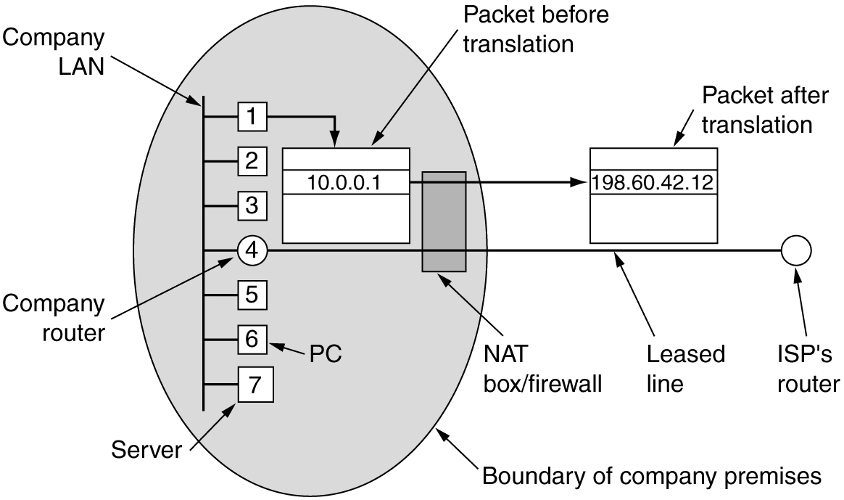
Placement of Operation of a NAT Box
NAT: provides mapping between public IP address and private IP addresses

Slide 5




NAT Operations
Address Translation Table: 192.168.0.10; x 128.100.10.15; y
192.168.0.13; w 128.100.10.15; z
192.168.0.10;x
128.100.10.15;y
Private Network
NAT Device
Public Network
192.168.0.13;w
128.100.10.15; z
Hosts inside private networks generate packets with private IP address & TCP/UDP port #s
NAT maps each private IP address & port # into shared global IP address & available port #
Translation table allows packets to be routed unambiguously

Slide 6
NAT Discussions
In theory, up to 2^16 private IP addresses supported by a single public IP address in NAT box
Overhead in NAT operation
TCP/UDP Port number used for NAT mapping at IP layer, violating OSI layer architecture principle

